Slide 1

Liability & Personal Assistants
Liability

Slide 2
Presentation Index
Class Organization (1 min)
Legal Issue/Case Study Overview (1.5 mins)
DS Issue Overview (1.5 mins)
Activity #1 Overview (1.5 mins)
Activity #2 Overview (1.5 mins)
Questions (3 mins)

Slide 3
Class Organization
# | Step | Mode | Duration
1 | Input: Introduction to Legal Liability and AIs Challenges | Plenary | 10
2 | Presenting the case-study | Plenary | 10
3 | Activity 1: Preparing Client’s Arguments | Teams | 30
 | Break |  | 15
4 | Input: Introduction to Ethics and AI | Plenary | 15
5 | Additional Discoveries | Plenary | 5
6 | Activity 2: Updating Arguments | Teams | 40
 | Break |  | 15
7 | Team Presentations and Discussions | Plenary | 30
8 | Wrap-Up & Q&A | Plenary | 10
Main Activity:
Mock Trial Format
Driver VS Victim VS Manufacturer
3 Teams Present
Deliverables:
Slide Deck from Activity #1
Slide Deck from Activity #2

Slide 4

Legal Issues Overview
Some of the main legal aspects are:
Legal personhood issues
Intellectual property issues
Liability for damages
Lack of accountability for harms

Slide 5

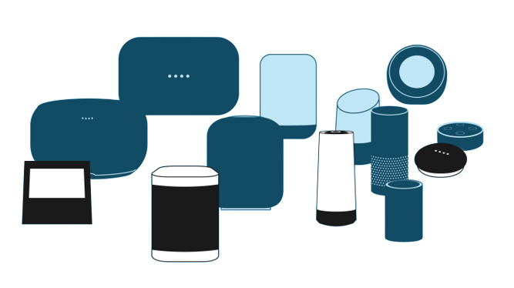
DS Issue Overview
Personal Assistance AIs are prevalent:
How do they work?
What are the limiting factors in development and training?
How do we attribute responsibility?

Slide 6

Activity #1 Overview
Mock Trial Preparation:
Teams split between two parties
Prepare initial arguments
Prepare initial cross-examination
Case Study:
Hit and Run
Serious injury & Negligence
Several Third Parties involved
Personal Assistance AI Involvement

Slide 7
Activity #2 Overview
Continuation of Activity #1:
Introduction of additional information: Hint #2.
Step #2 of preparations to mock trial.
Data Analysis.

Slide 8
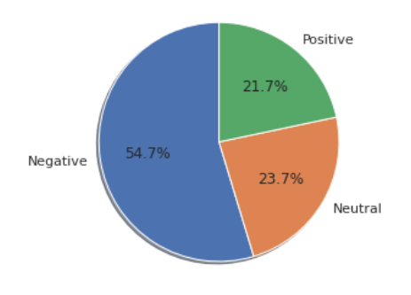
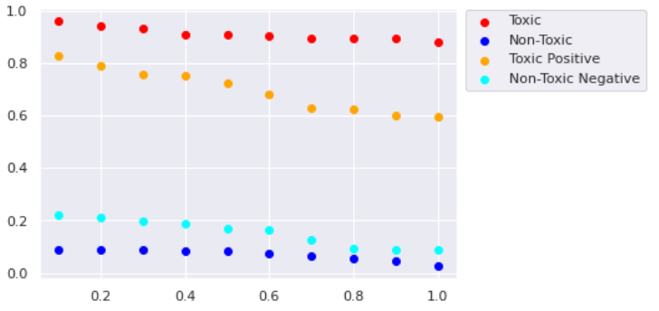
Activity #2 Overview

Slide 9
Thank you!
Obrigado! Grazie! Благодаря! (Blagodaria!) (Toda!) !תודה

